Slide 1
Using Python for Scientific Data Management
Matthias Hofmann, @TUM, 2025

Slide 2
What to Expect
Mixed style presentation (PowerPoint + guided demo)
Example files provided via GitHub
workshop https://github.com/tgaedt/workshop
workshop_uv https://github.com/tgaedt/workshop_uv

Slide 3
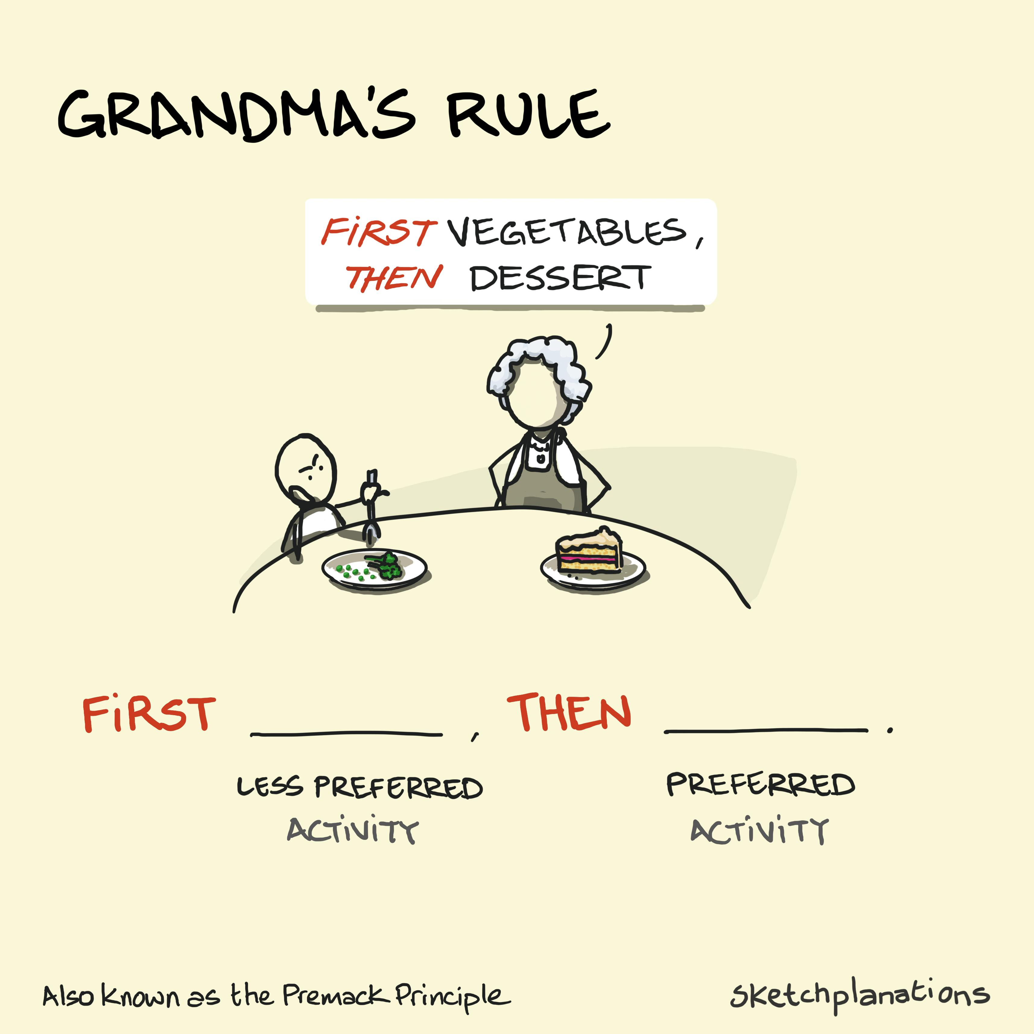

Slide 4
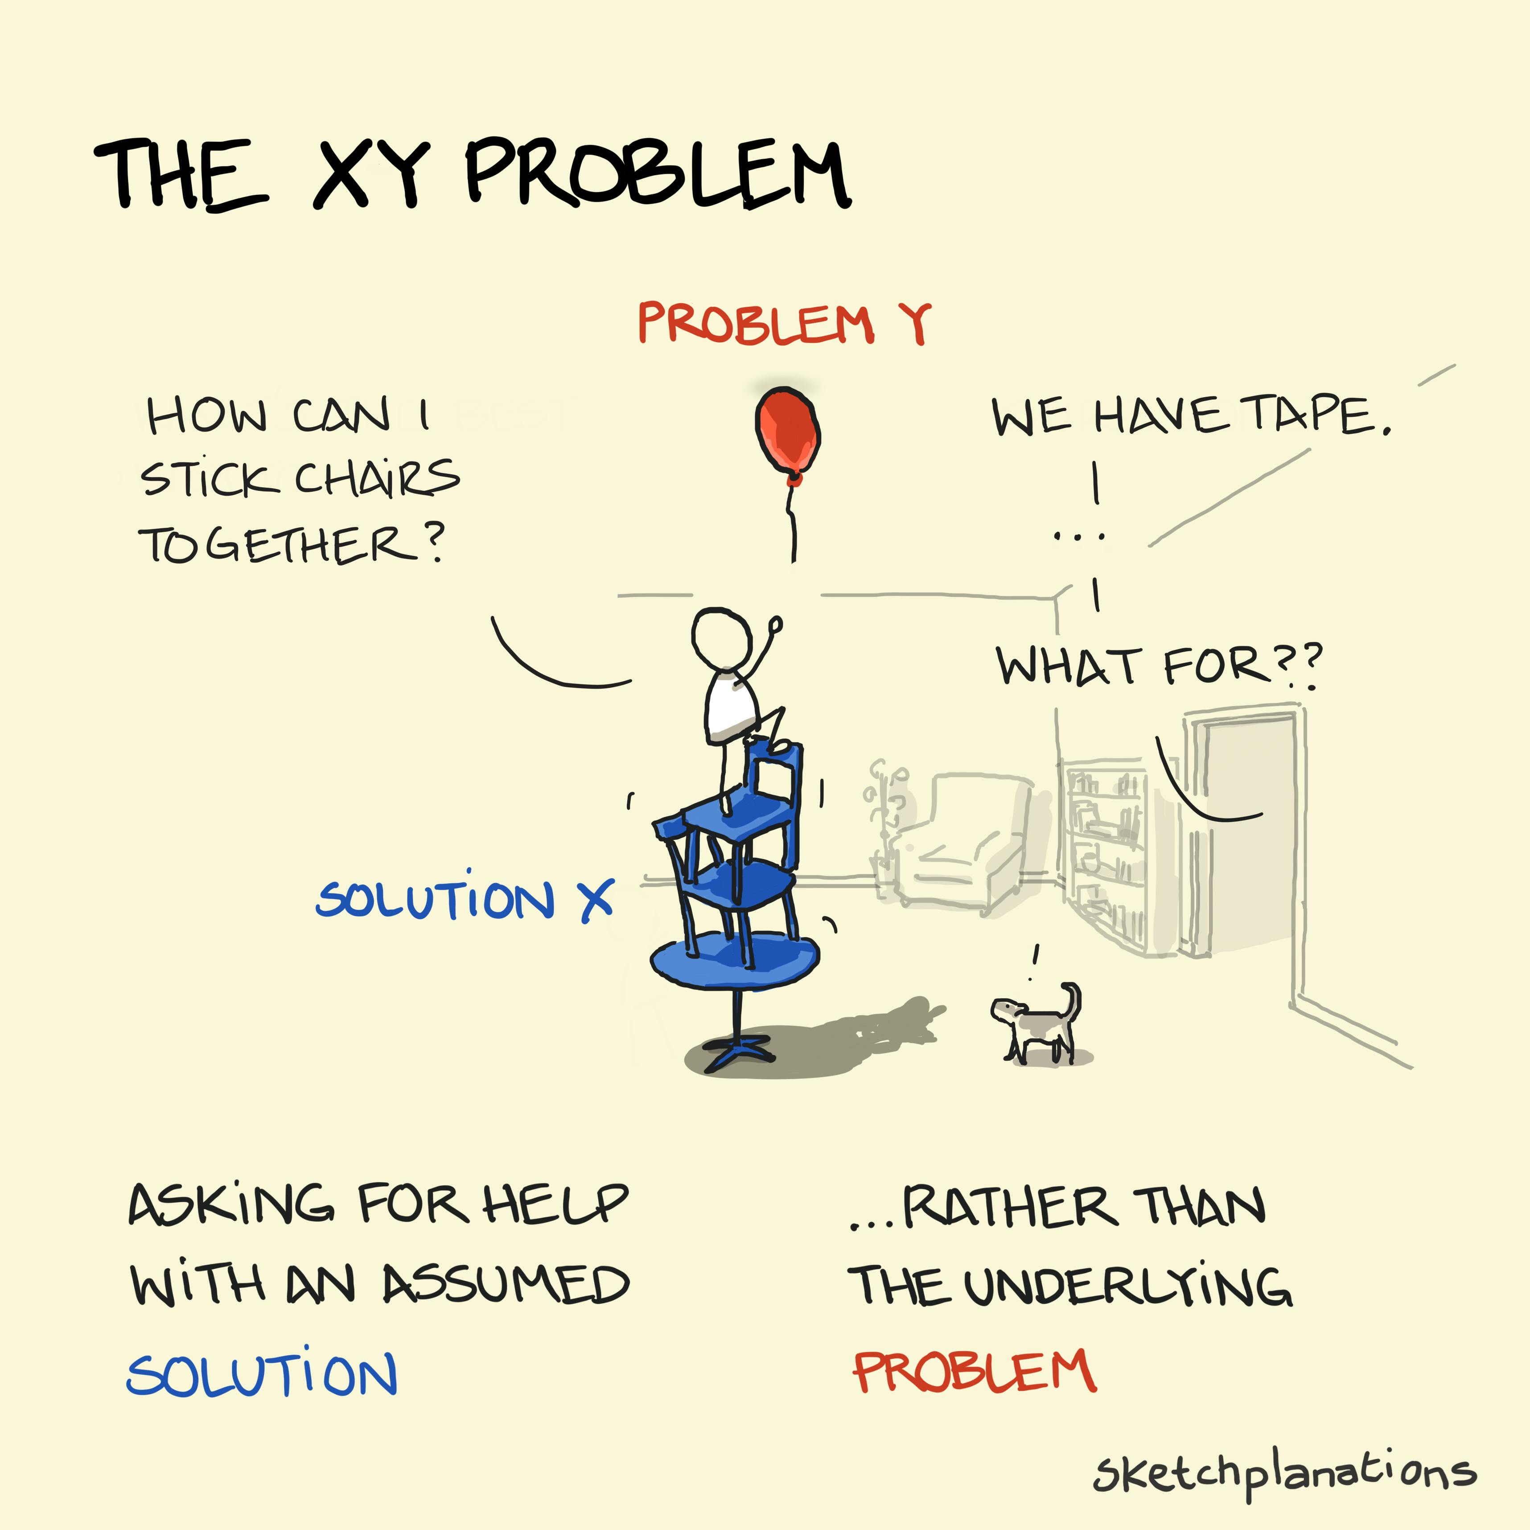
Presenting The Challenge
Ensure long-term sustainable access to data
How to make data accessible to yourself, your colleagues and institue?
How to make best use of the data in the sense of drawing conclusions and decision making?
How to reuse experimental results?
How to share data and information?

Slide 5
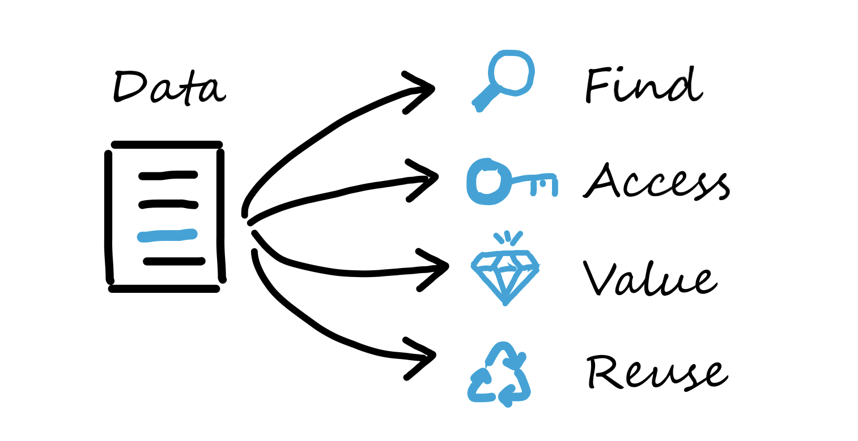
Optimize the reuse of data – the FAIR principle
In 2016, the ‘FAIR Guiding Principles for scientific data management and stewardship’ were published in Scientific Data. The authors intended to provide guidelines to improve the Findability, Accessibility, Interoperability, and Reuse of digital assets.
https://www.go-fair.org/fair-principles/

Slide 6
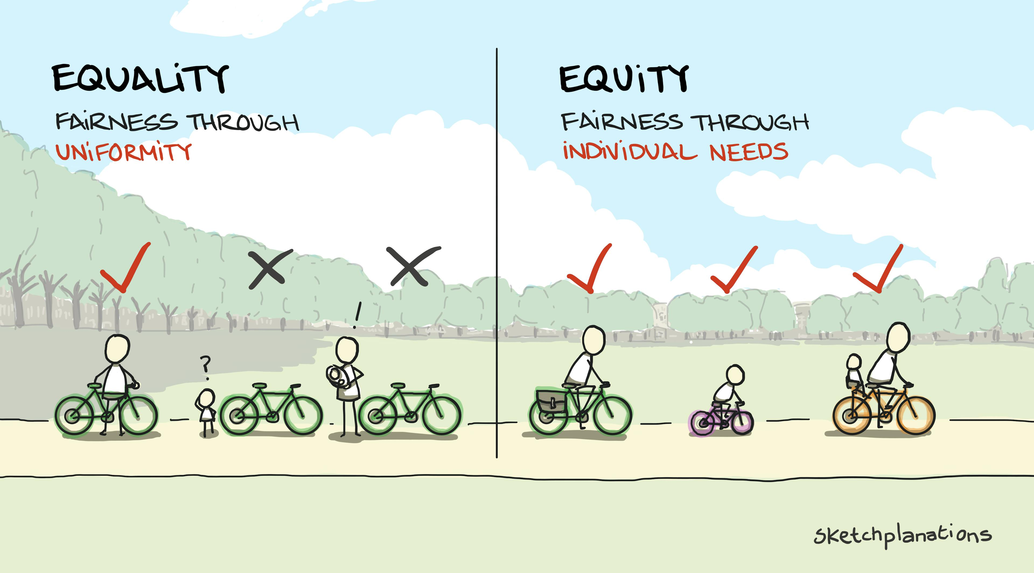
Take into Account the Individual’s Perspective

Slide 7
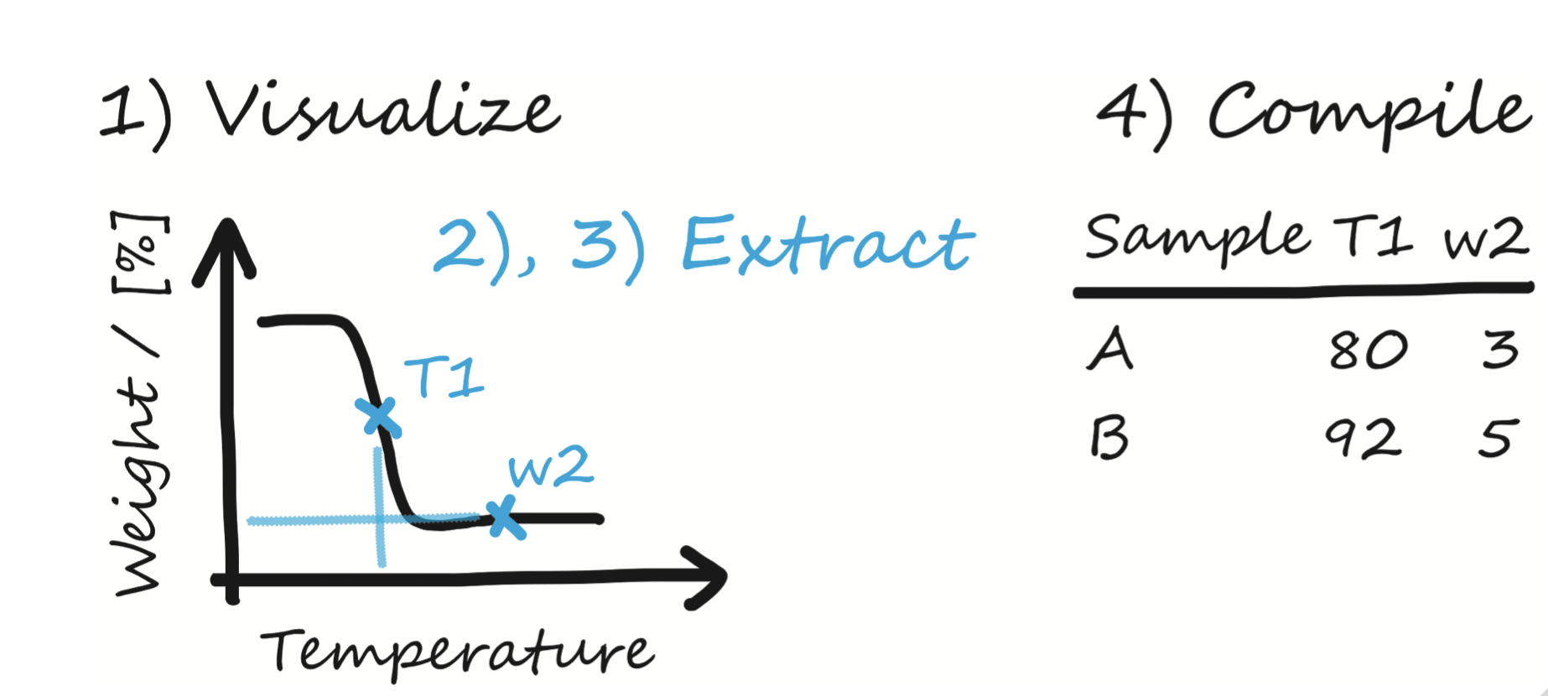
Standard Perspective Leads to Standard Type Results

Slide 8
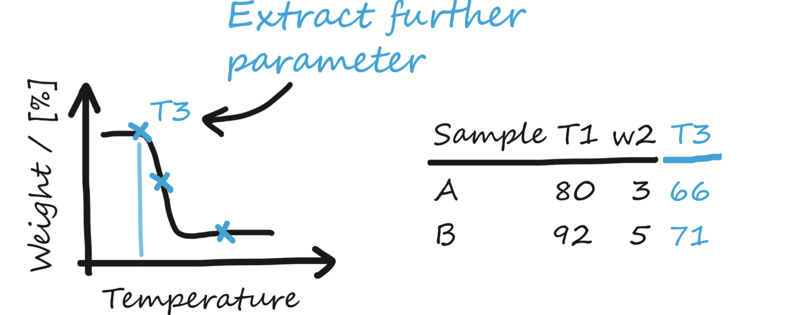
New Perspective Requires Access to Source Data

Slide 9
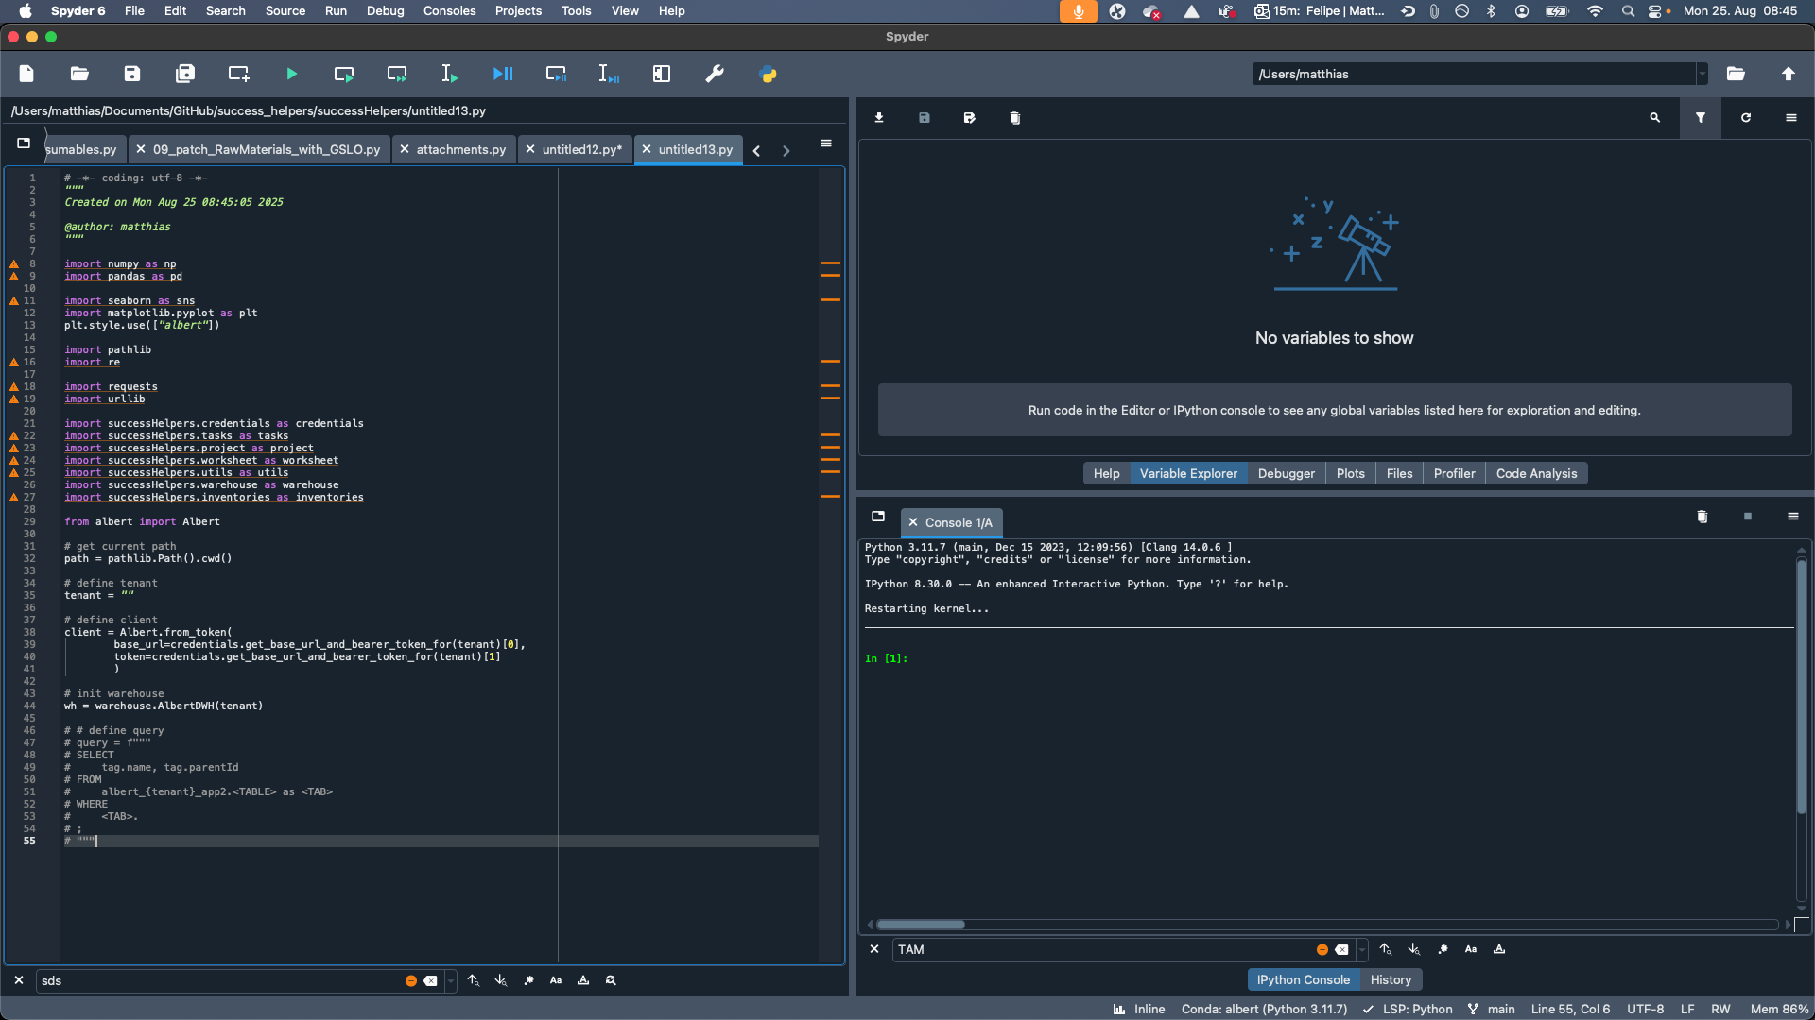
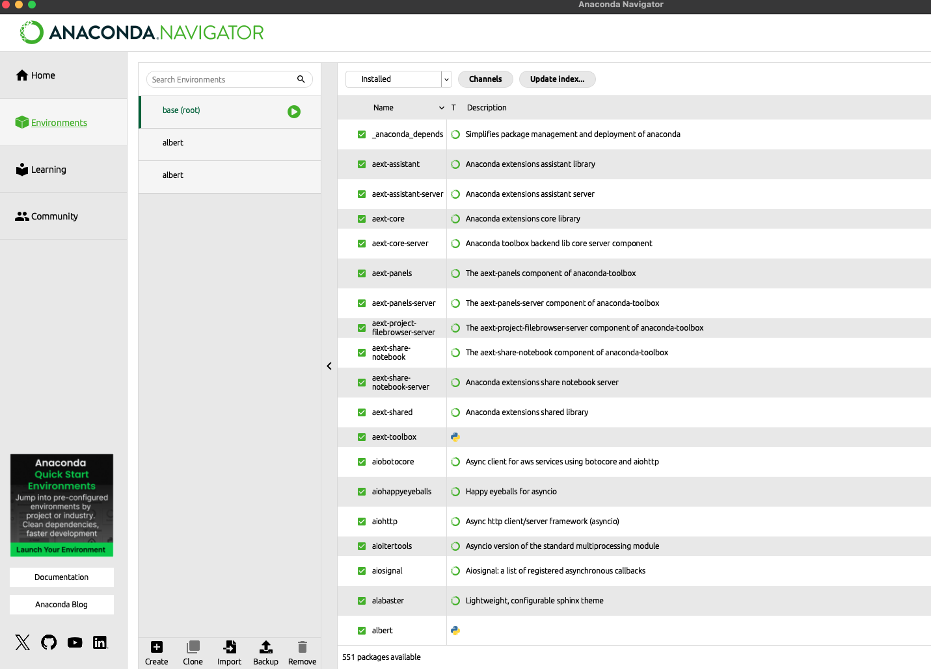
Python Quick Start
🎬 show IDE / setup

Slide 10
Essential Data Types in Python – Check ✅
int, float, str
list, tuple, set
dict
pd.DataFrame
🎬 01_create_df.py
🎬 02_df_plot.py
🎬 03_df_melt_pivot.py
🎬 04_pivot_larger_df.py

Slide 11
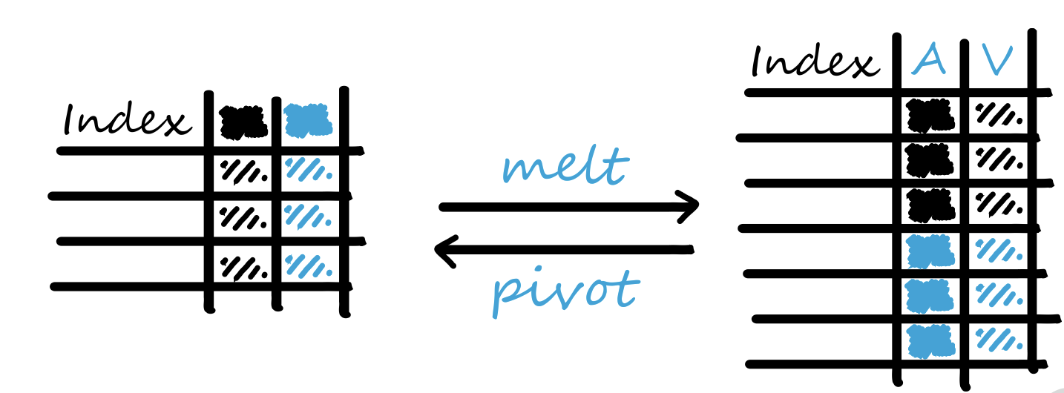
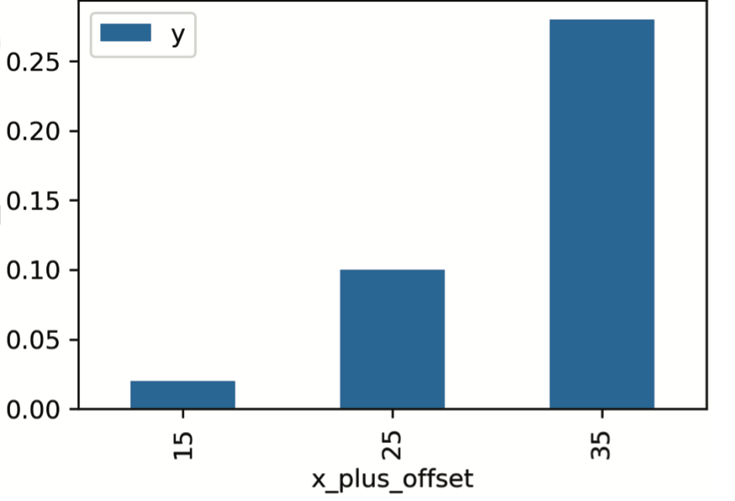
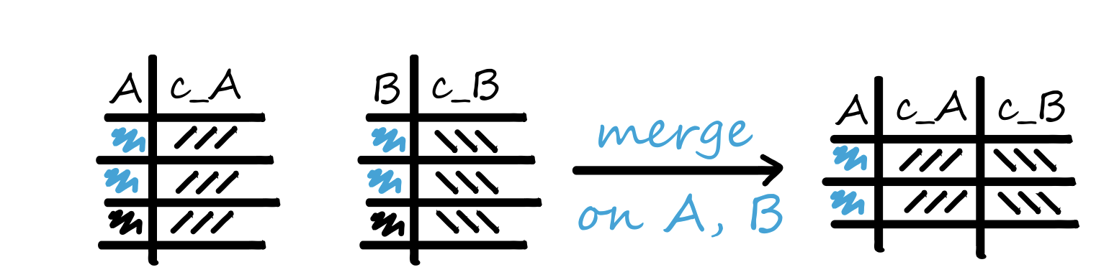
pd.DataFrame Essentials – Check ✅
.plot
.pivot & .melt
.merge

Slide 12
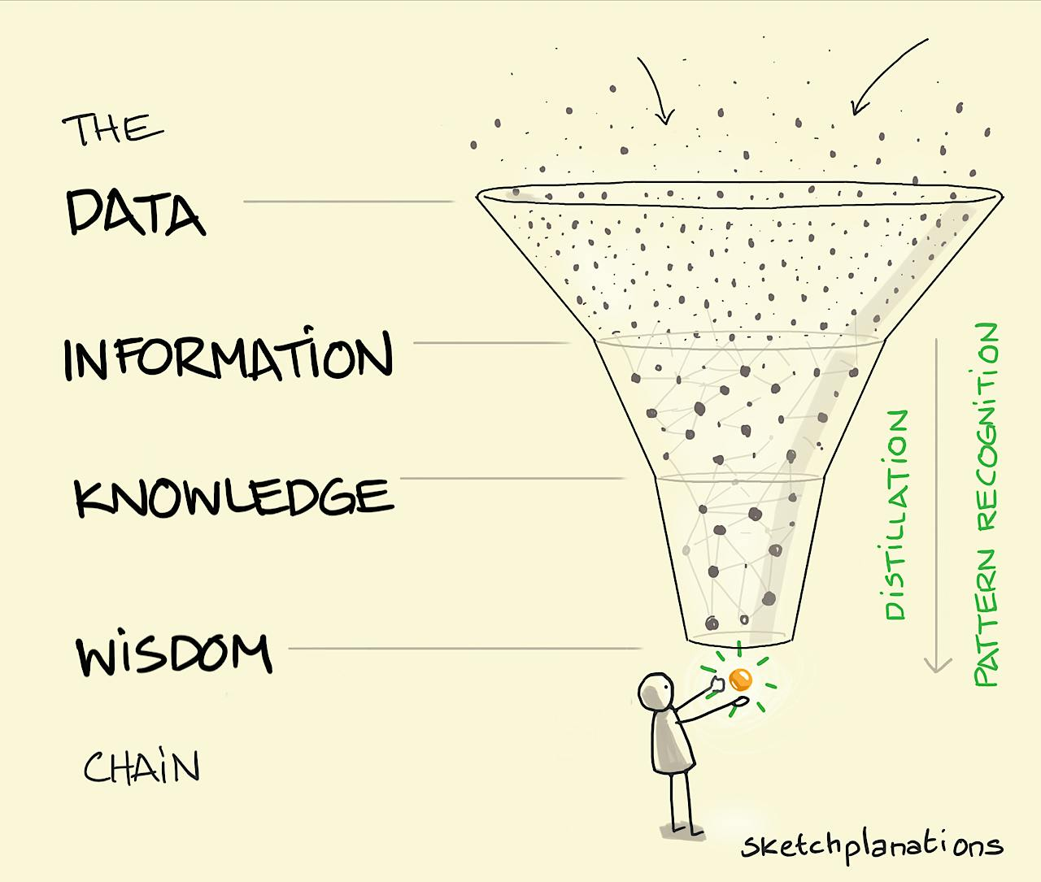
Steps of Data Processing – Distilling the Essence

Slide 13
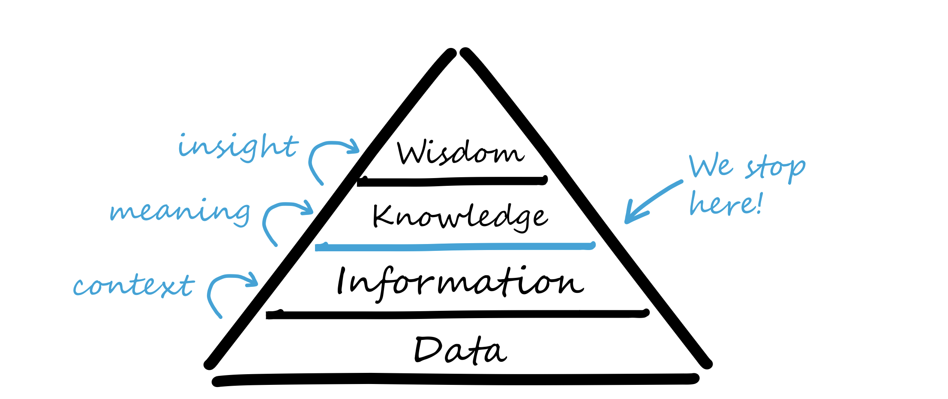
Steps of Data Processing – Distilling the Essence

Slide 14
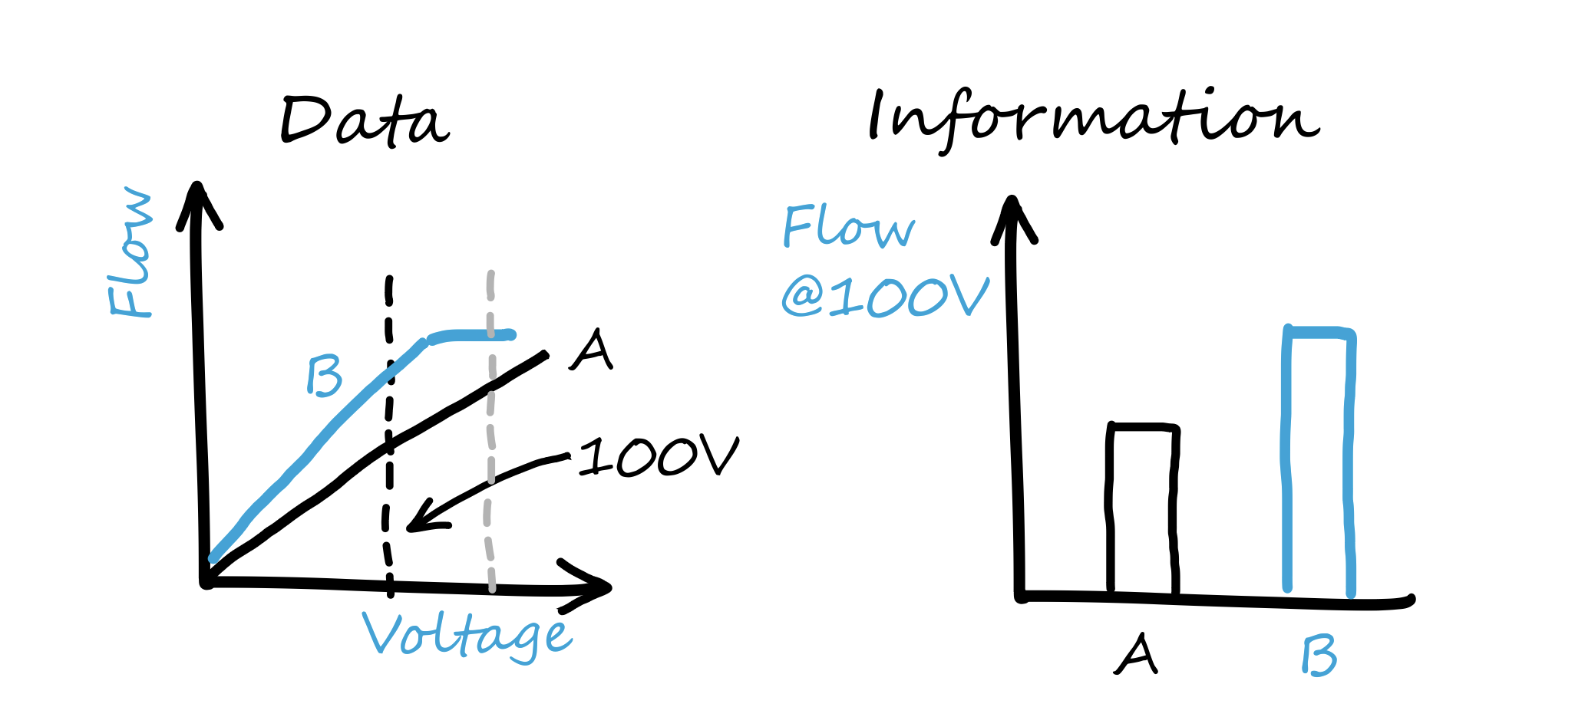
Information – A matter of Perspective 👀

Slide 15
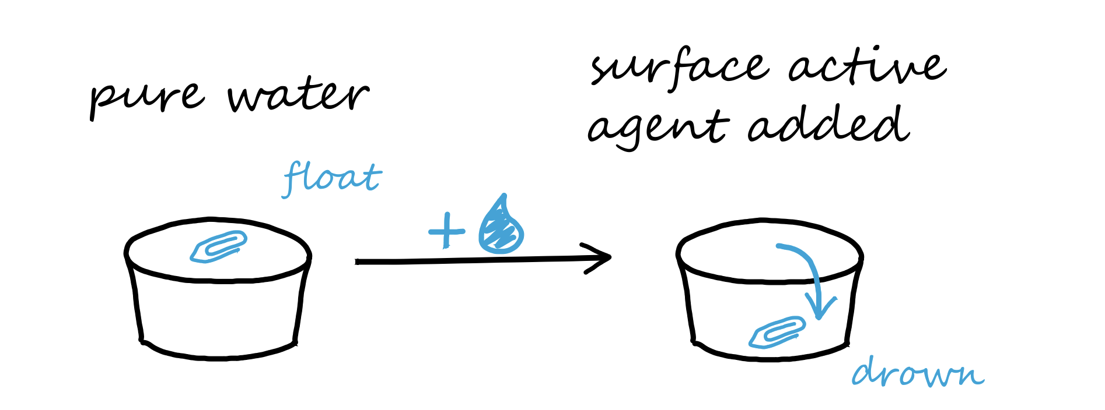
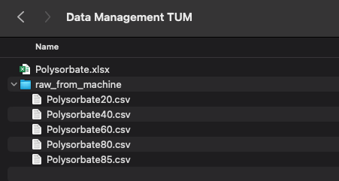
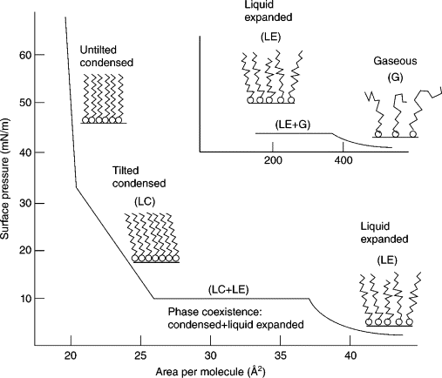
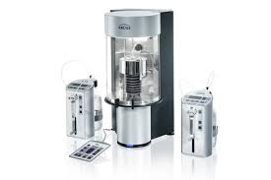
Experiments and “Data Land”
Lab / ”real world”
”Digital world”
Surfactant
characteristics
Experimental “raw
Files” / results
🎬 set up folder structure

Slide 16
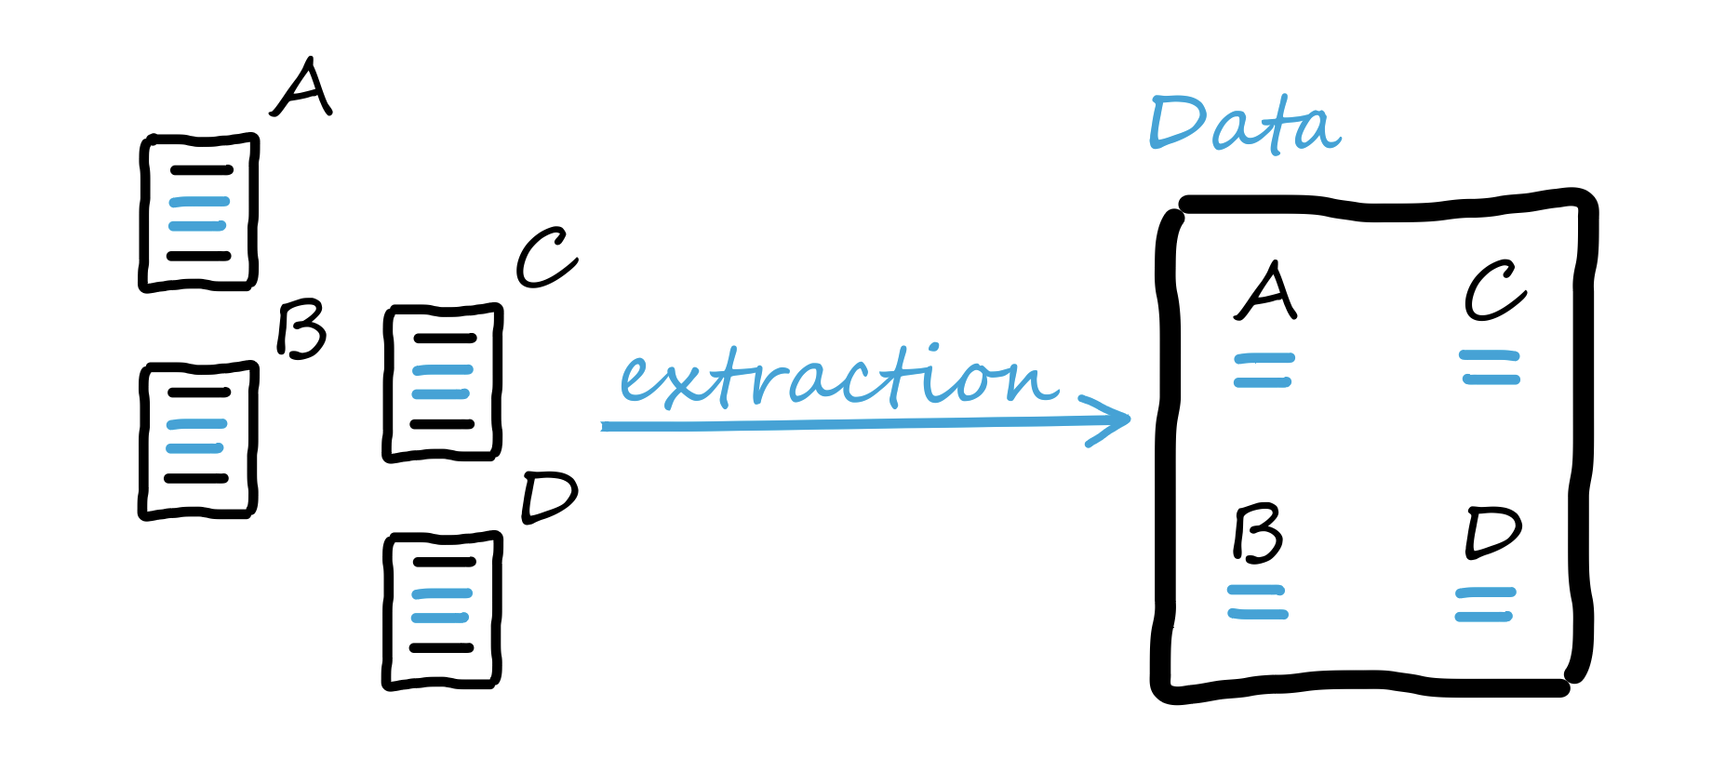
From Experimental Files to Data

Slide 17
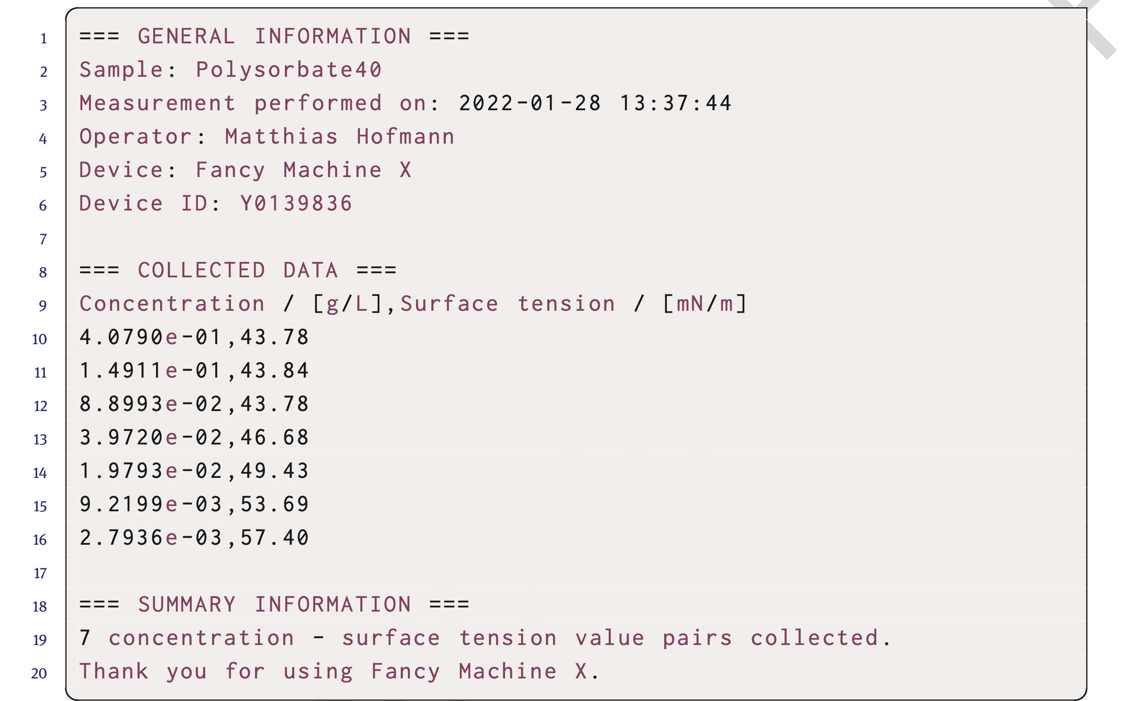
Understand the Files’ Structure
🎬 open file and “dice” it
🎬 build 01_get_data_pandas.py

Slide 18
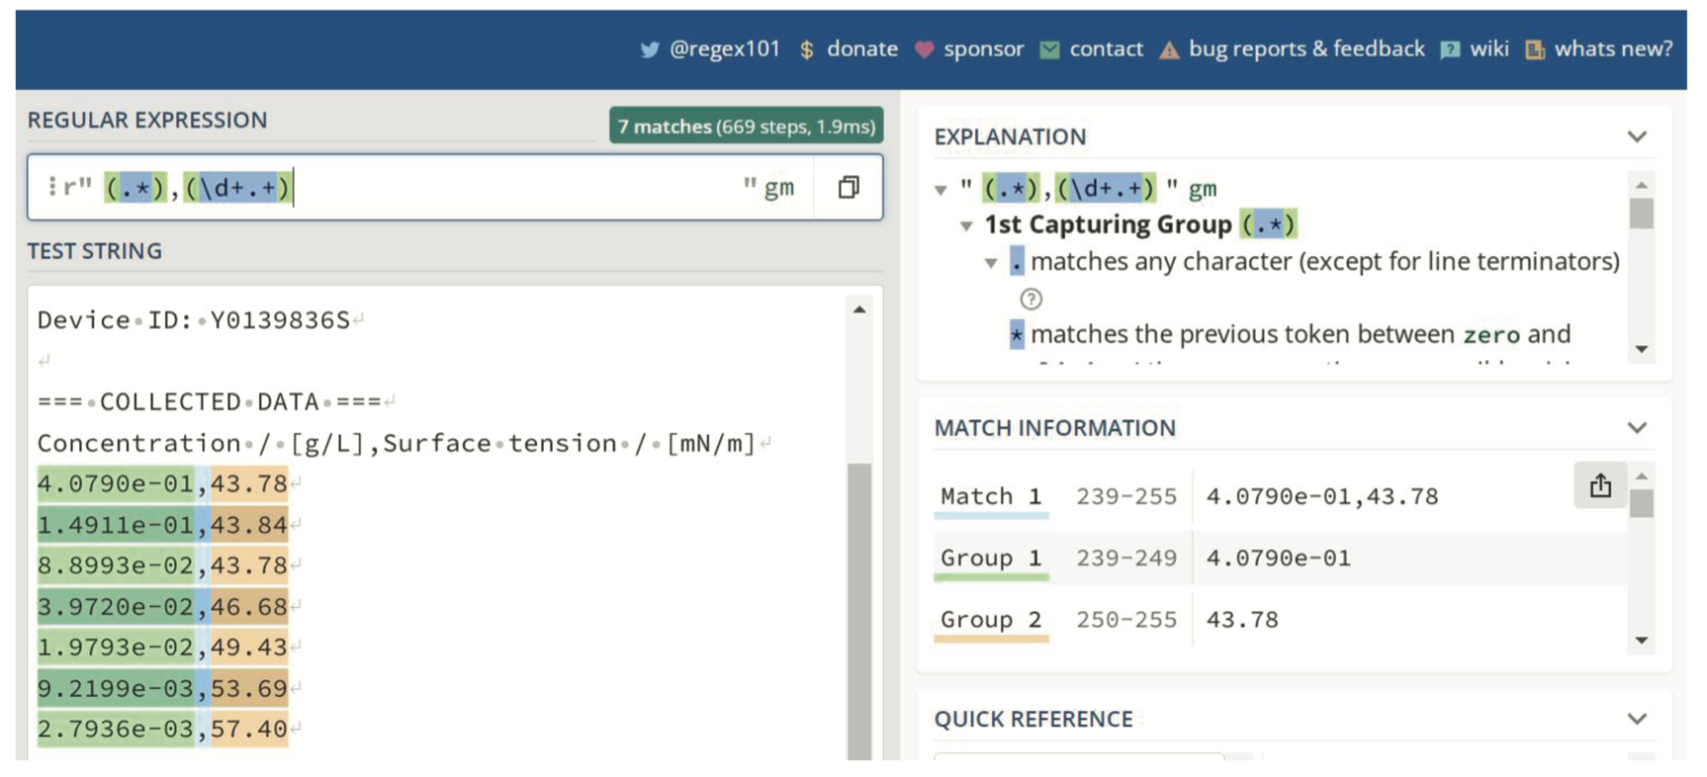
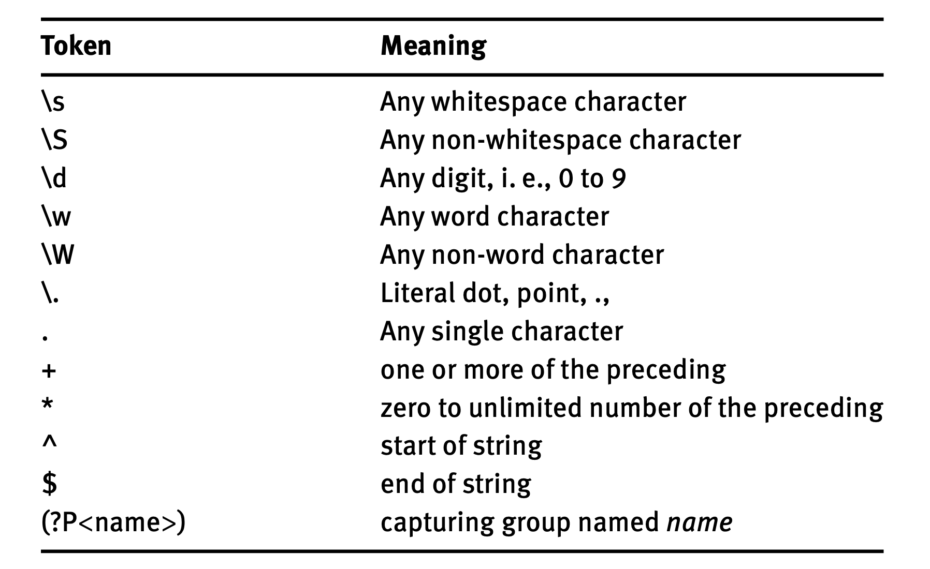
Extract ”Data Piece”
🎬 build 02_get_data_regex.py
🎬 build 03_get_data_regex_short.py
🎬 show get_data_short.py

Slide 19
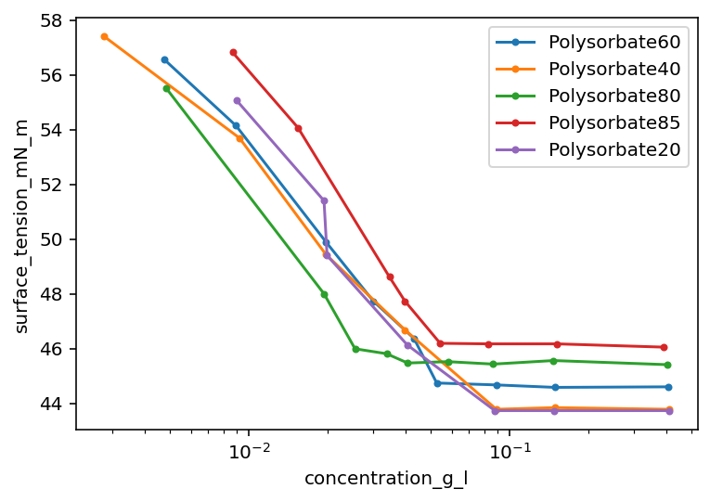
Extract&Show ”Data Piece” – Repeated 🔂
🎬 build 04_get_and_plt_via_module.py

Slide 20
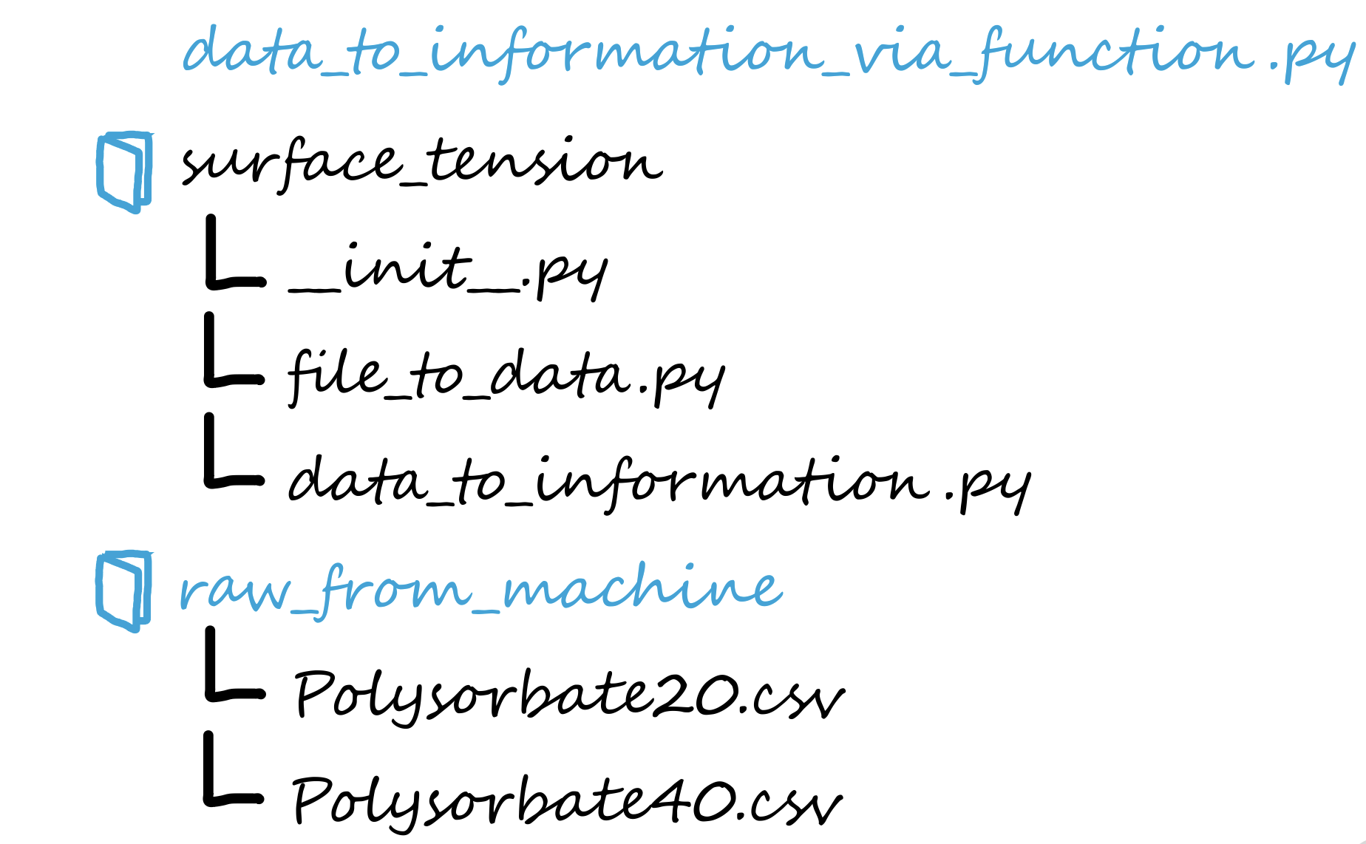
Folder Structure for modules
🎬 build folder structure

Slide 21
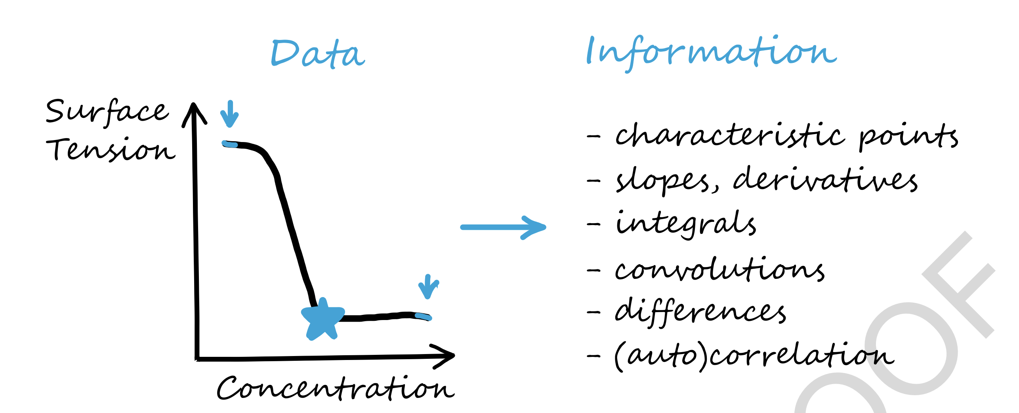
From Data to Information

Slide 22
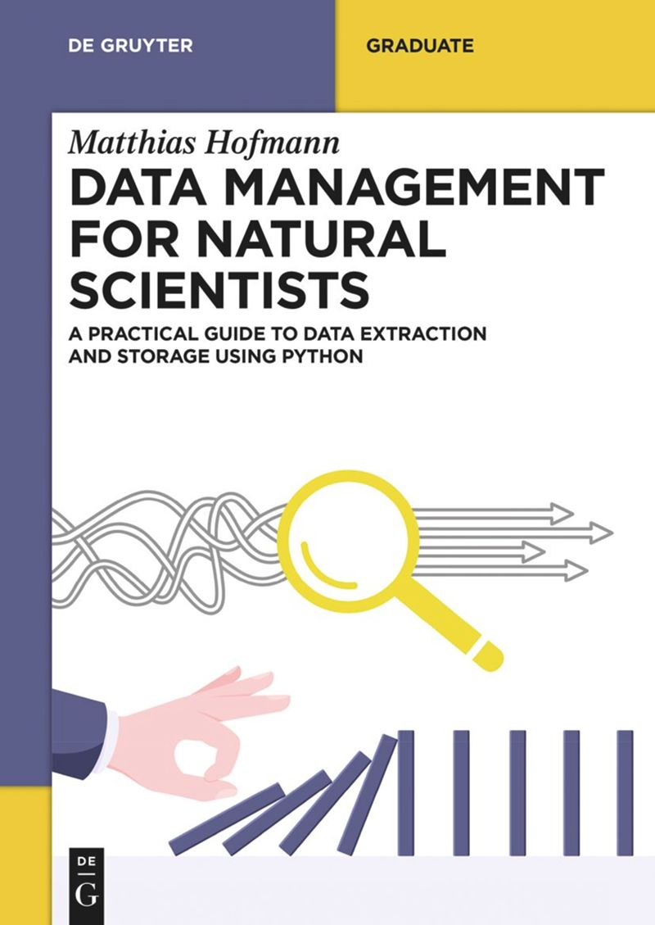
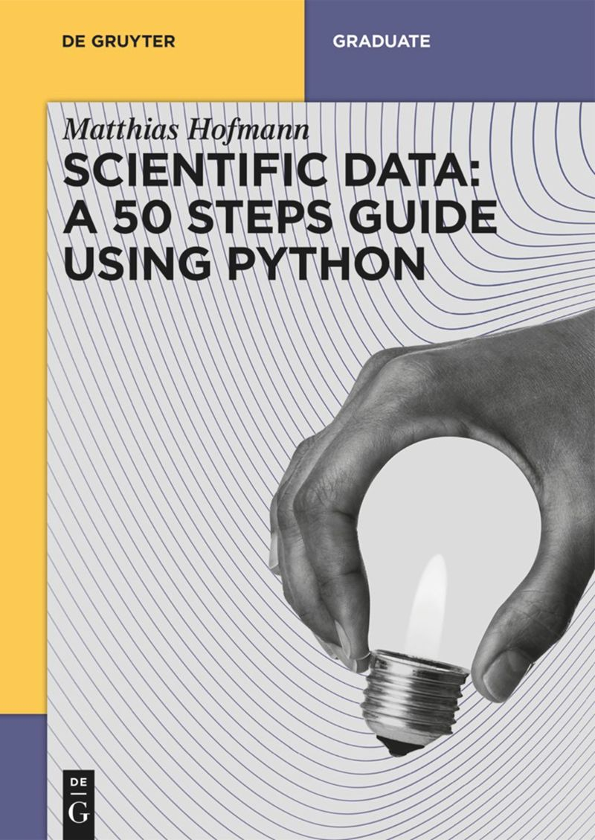

Further Reading
See Data Management for Natural Scientists See Scientific Data: A 50 Steps Guide using Python
See CaloCem tool
Github
Documentation with Tutorial

Slide 23
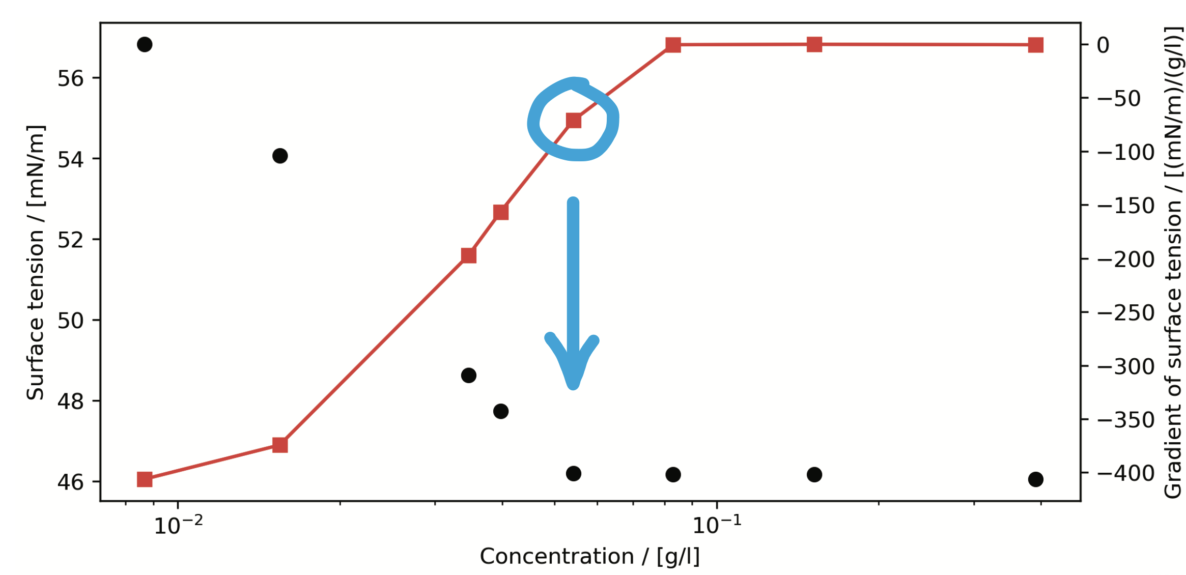

Slide 24
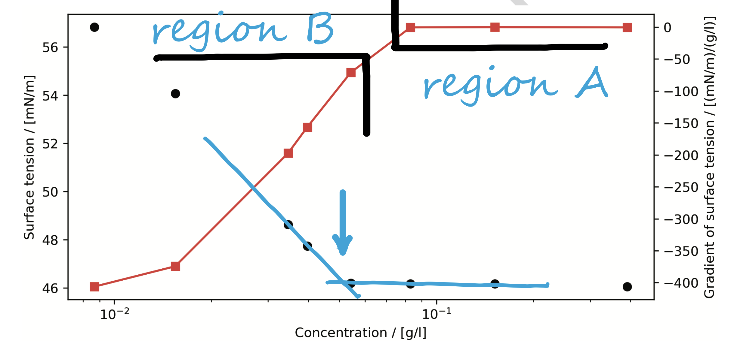

Slide 25
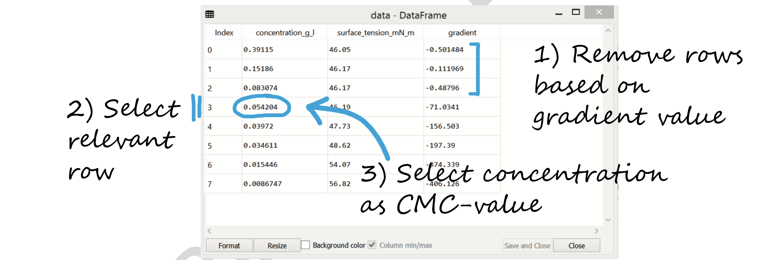

Slide 26
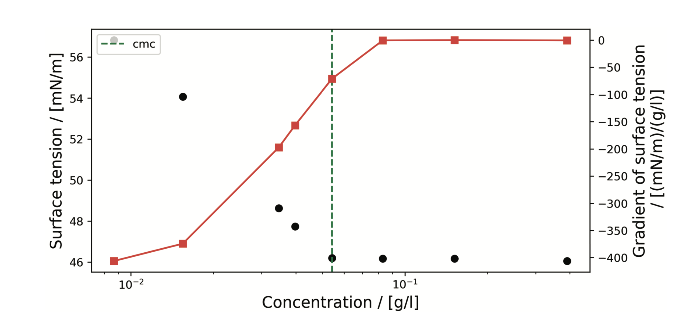

Slide 27
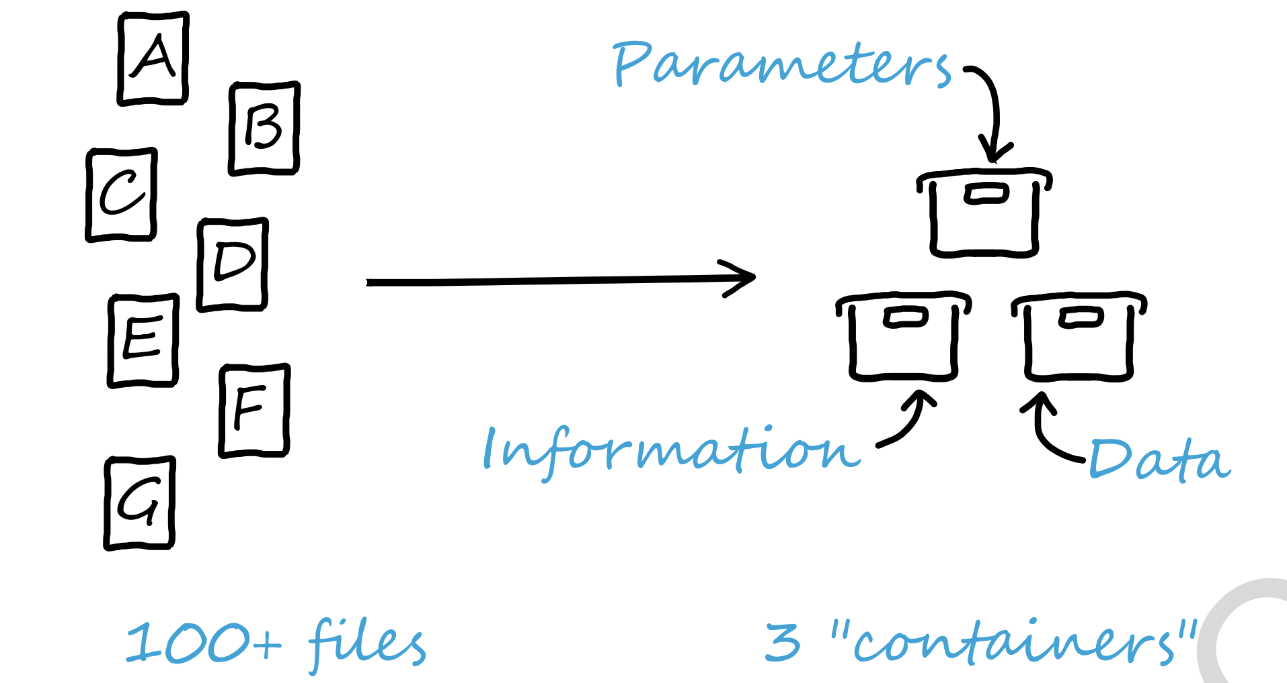

Slide 28
